Slide 1
Stopwatch App Story Board
HCI – Group 2

Slide 2
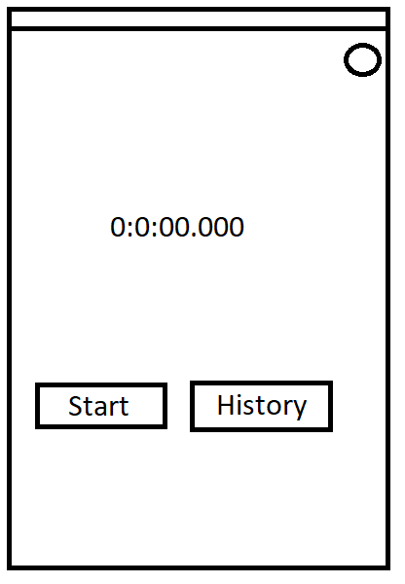
1. The user arrives at the track and opens the application

Slide 3
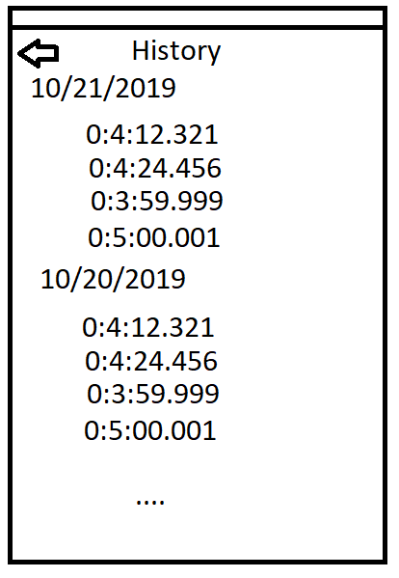
2. The user checks his times from yesterday, as well as his times from the beginning of the year to see what he needs to beat

Slide 4
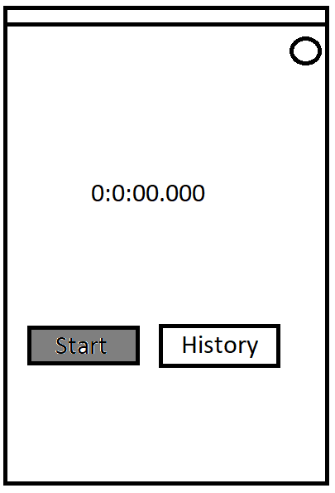
3. The user hit’s start

Slide 5
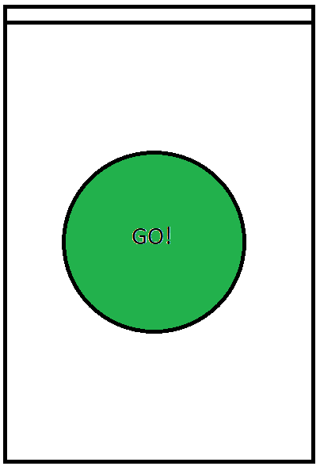
4. The application counts down from three with sounds, and then says GO with a different chime

Slide 6
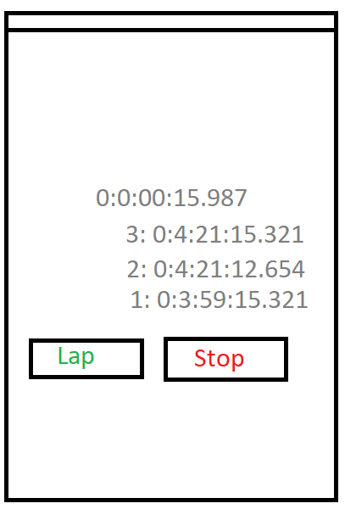
5. The user runs around to complete a lap, and then hits the lap button. This is repeated 3 times

Slide 7
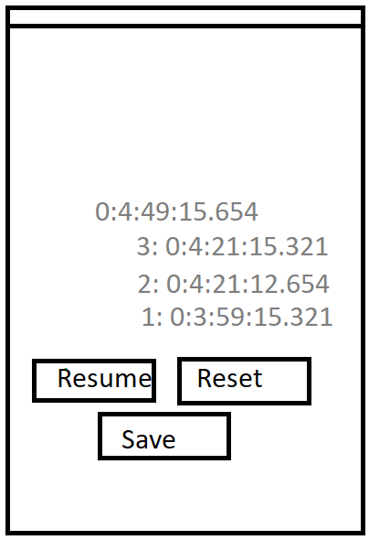
6. The user finishes the fourth lap and hits stop

